Slide 1

FORFEIT
Batch:A13
Name of the students: Name of the guide:
V.Mahima (154G1A0544) Mr.G.Hemanth Kumar Yadav, M.Tech.,
P.Mounika Bai (154G1A0548) Assistant Professor.
P.Gouse Ashwak(154G1A0547)
D.Keerthi(154G1A0539)
Srinivasa Ramanujan Institute of Technology
Department of Computer Science & Engineering

Slide 2
Abstract:
The primary objective of "FORFEIT Application" is to maintain the records of those people who violates the traffic rules. This app lets the Traffic police to collect fines in a smart way just by capturing the vehicle's number plate. The captured number plate image is converted to text by using the Text Recognition methodology(Optical Character Recognition).
The recognized text will be compared with the RTO database and the details of the user will be retrieved and the rule that is broken is selected by the police and corresponding fine will be generated.

Slide 3
Contents:
Problem Statement
Proposed System
Literature Survey
Modules
Design
Implementation
References

Slide 4
Problem statement:
Now-a-days, traffic is increasing in leaps and bounds. The people are not following traffic rules properly.
In order to make them disciplined, fines need to be collected. This should be done in an advanced way.
Instead of noting down the vehicle number and sending it to RTO Office and couriering the notices to their addresses, we should find a better way. The way is to go with “FORFEIT” Application.

Slide 5
Proposed System:
Capturing the image of the vehicle’s number plate and processing it in FORFEIT Application by using the Text Recognition Methodology(Optical Character Recognition).
This app lets the traffic police to know about the owner of the vehicle, details, previous rule violations done, and the corresponding fine that is to be generated based on the violation.
We can manually enter the vehicle number in certain cases where image capturing is not supportive.

Slide 6
Benefits of FORFEIT:
Reduces the effort on Police man to generate fines to the people.
It helps the Police to do work in a smart way just by capturing pictures.
It helps the user to keep a record of his rule breakages.
Helps people to be more careful.

Slide 7
Literature Survey Existing System:1.Digital Image Processing
This system converts the digital image into text.
Steps included here are Image Extraction, Image Preprocessing, Character Segmentation, Information Recognition, Generating Results.
This system can recognize English letters and Digits.

Slide 8
Existing System: 2.RTO Checker Android Application
In large cities, the number of vehicles is enormous and the arrival rate of traffic monitoring stream is very high.
This system maintains the records of the owners of the vehicles.

Slide 9
Modules:
User Interface
-Login Activity
Optical Character Recognition
-Scan picture
-Check the violations
Database Retrieval
-View details
-Generate fines

Slide 10
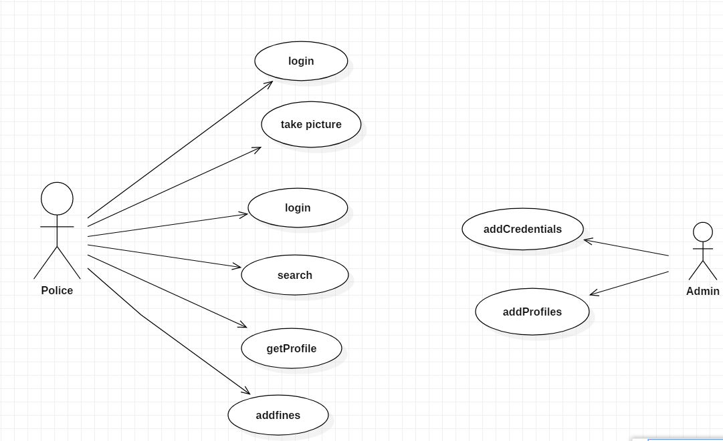
Design: Use-case diagram

Slide 11
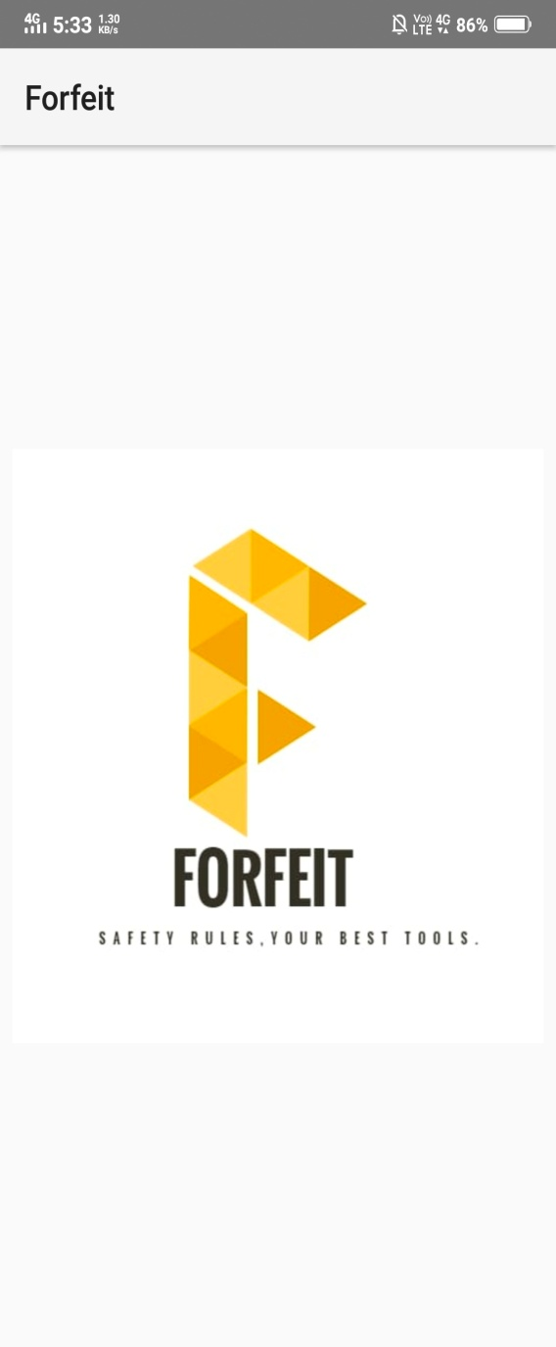
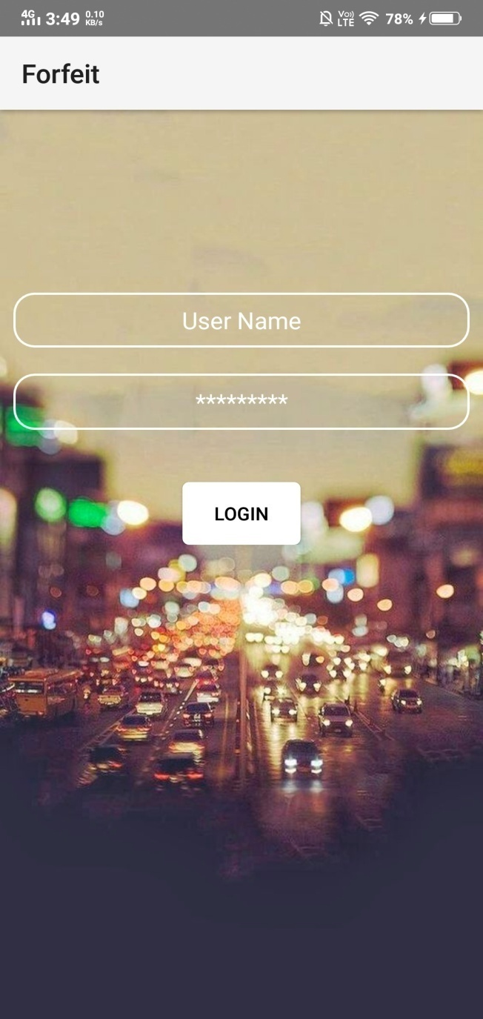
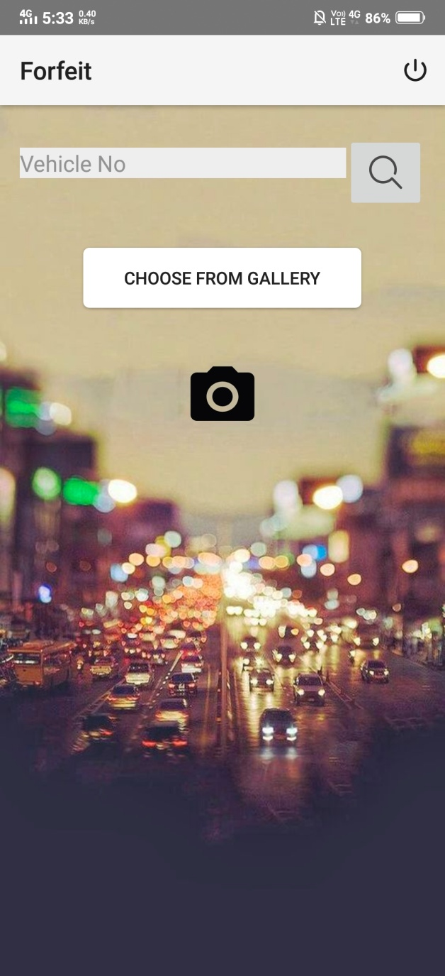

Slide 12
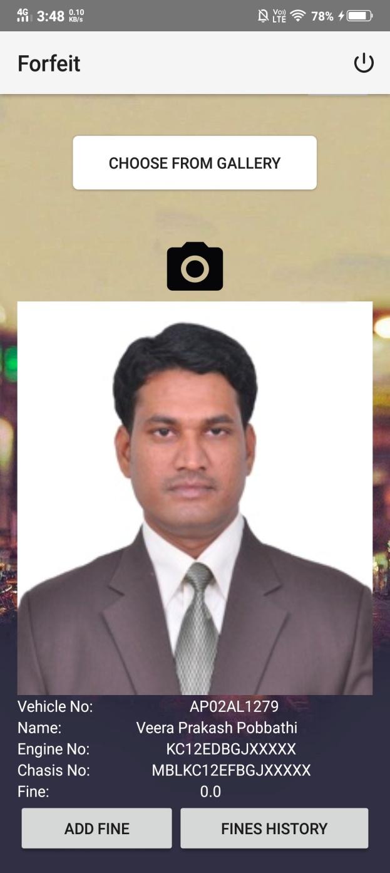
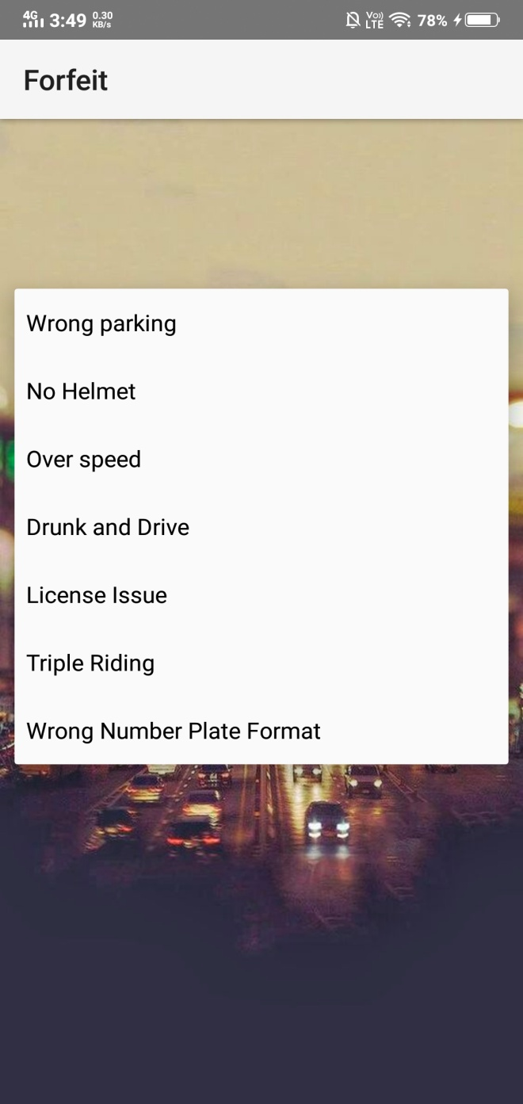
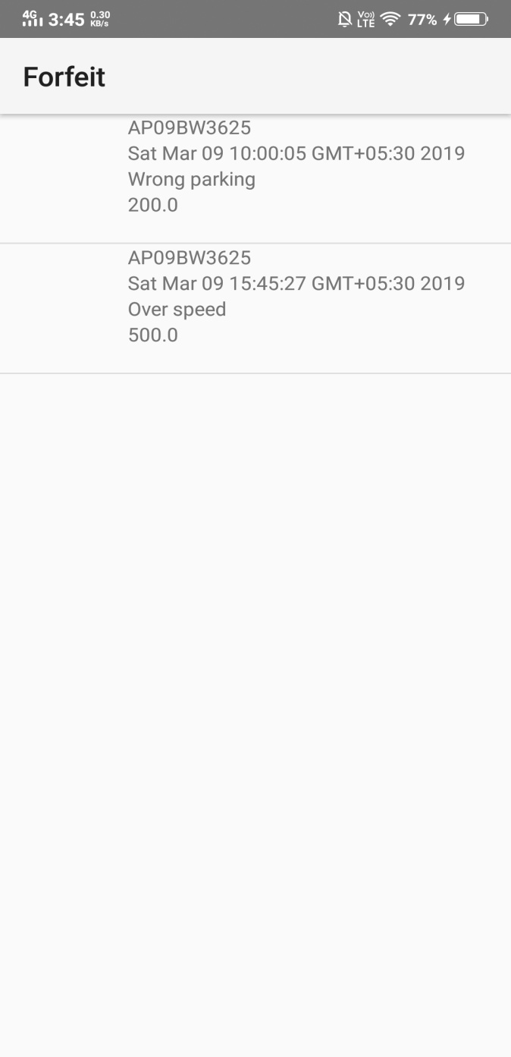

Slide 13
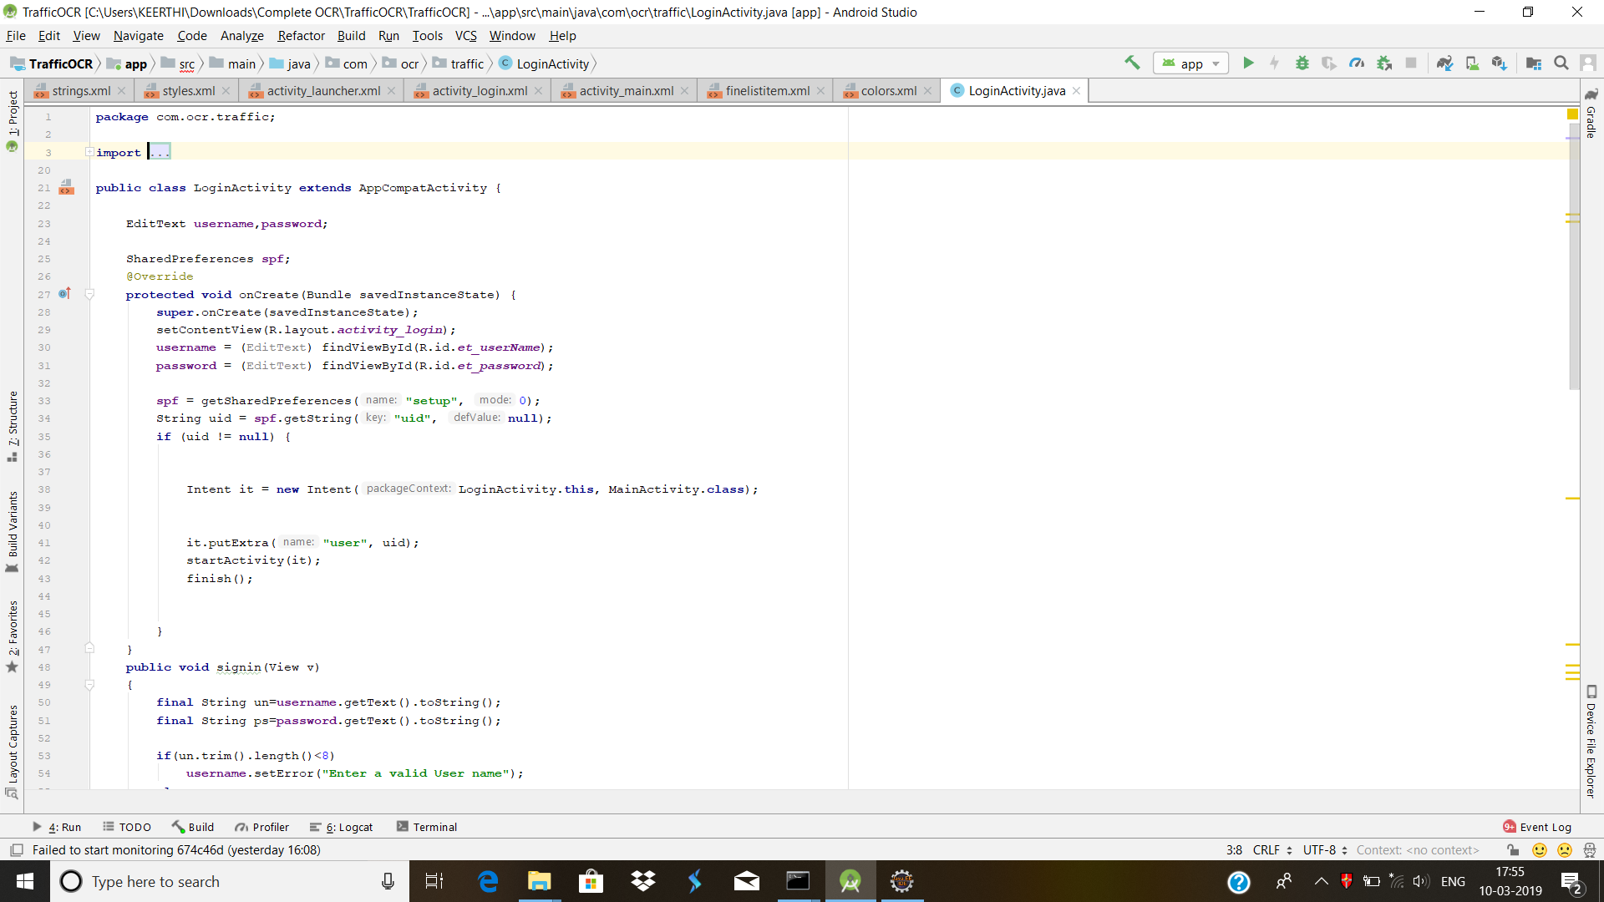
Implementation:

Slide 14
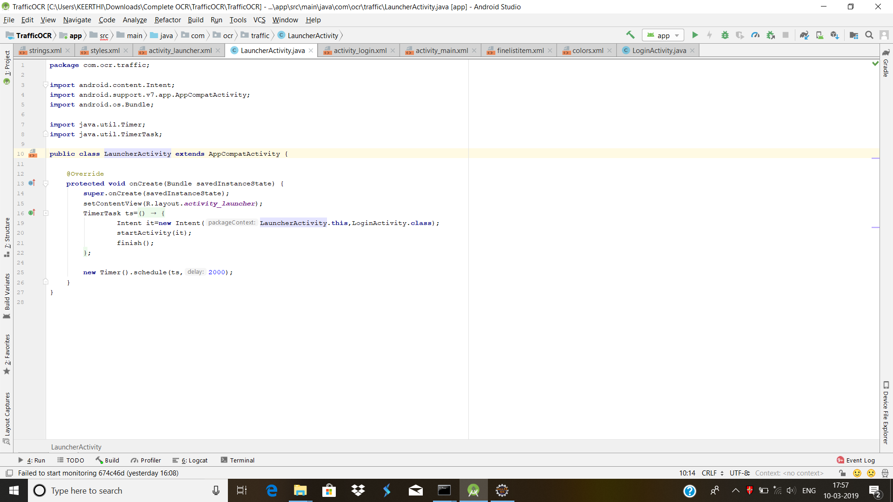
Contd..

Slide 15
OCR Algorithm Process:
OCR is a technology that converts image into digital text.
The chosen image must undergo some preprocessing in this step.
Image is straightened and pattern is recognized.
The recognized pattern is converted from color to a binary image.
The image consists of black and white colors only.
The algorithm identifies a character by analyzing the lines, strokes that makes it.

Slide 16
Contd…
The second approach pattern recognization works by identifying the character as a whole.
We can identify a line of text by looking for rows of white pixels with rows of black pixels in between.
In the same way we can identify what an individual character begins and ends.
We convert the image of the character into a binary matrix with 0's and 1's.
Thus the pattern can be recognized.

Slide 17
References:
[1] https://ieeexplore.ieee.org/document/7193210
[2] RTO Checker Android Application.
[3]https://developers.google.com/vision/android/getting-started
[4] https://cloud.google.com/vision/docs/ocr

Slide 18
Comments:
Improve UML Diagrams.
Display image while showing the fine history.
Added another feature : Import from Gallery.

Slide 19
Thank you
Queries
?

